Slide 1
Object Oriented Software Engineering (OOSE)
22CS017
Activity Diagram

Slide 2
Index
What is Activity Diagram
Components of Activity Diagram
When to use Activity Diagram
Practice Questions
Bibliography

Slide 3
Activity Diagram
Activity diagram is used to demonstrate the flow of control within the system rather than the implementation.
It models the concurrent and sequential activities.
The activity diagram helps in envisioning the workflow from one activity to another.
It put emphasis on the condition of flow and the order in which it occurs. The flow can be sequential, branched, or concurrent, and to deal with such kinds of flows, the activity diagram has come up with a fork, join, etc.
It is also termed as an object-oriented flowchart. It encompasses activities composed of a set of actions or operations that are applied to model the behavioral diagram.

Slide 4
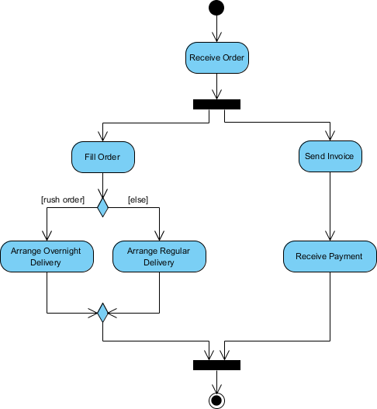
Activity Diagram
Figure 1: Example of Activity Diagram

Slide 5
Activity Diagram
Notation of an Activity diagram: -
Initial State: It depicts the initial stage or beginning of the set of actions.
Final State: It is the stage where all the control flows and object flows end.
Decision Box: It makes sure that the control flow or object flow will follow only one path.
Action Box: It represents the set of actions that are to be performed.

Slide 6
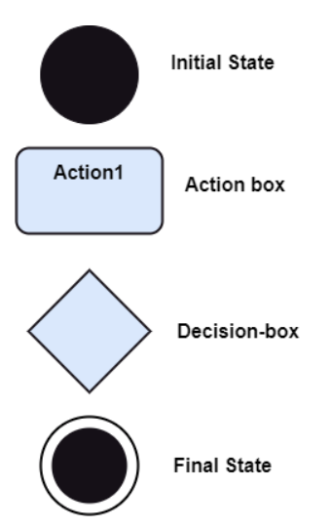
Activity Diagram
Figure 2: Notation of Activity Diagram

Slide 7
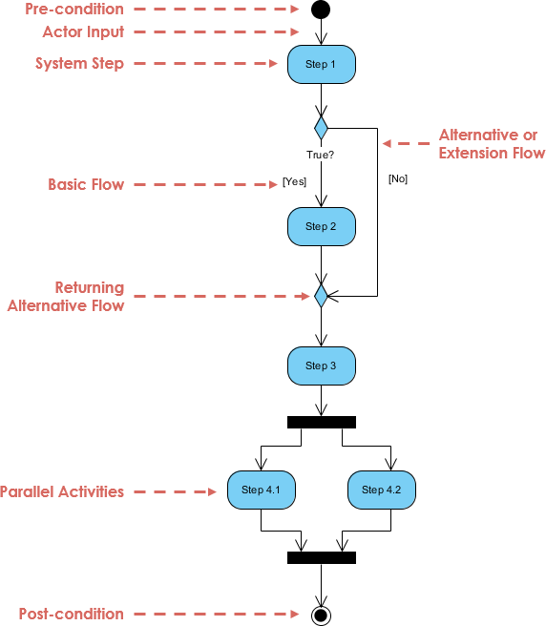
Activity Diagram
Figure 3: Working of Activity Diagram

Slide 8
Activity Diagram
Example : -
Input parameter is the Requested order, and once the order is accepted, all of the required information is then filled, payment is also accepted, and then the order is shipped. It permits order shipment before an invoice is sent or payment is completed.

Slide 9
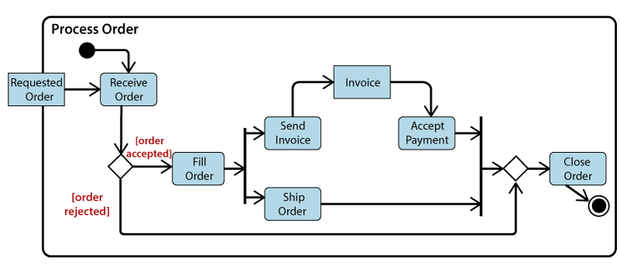
Activity Diagram
Figure 4: Example of Activity Diagram

Slide 10
When to use an Activity Diagram?
An activity diagram can be used to portray business processes and workflows. Also, it used for modeling business as well as the software. An activity diagram is utilized for the followings:
To graphically model the workflow in an easier and understandable way.
To model the execution flow among several activities.
To model comprehensive information of a function or an algorithm employed within the system.
To model the business process and its workflow.
To envision the dynamic aspect of a system.
To generate the top-level flowcharts for representing the workflow of an application.
To represent a high-level view of a distributed or an object-oriented system.

Slide 11
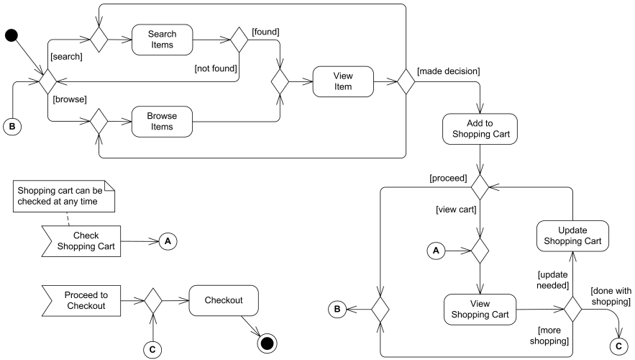
Online Shopping - Activity Diagram
Figure 4: Working of Online Shopping Activity Diagram

Slide 12
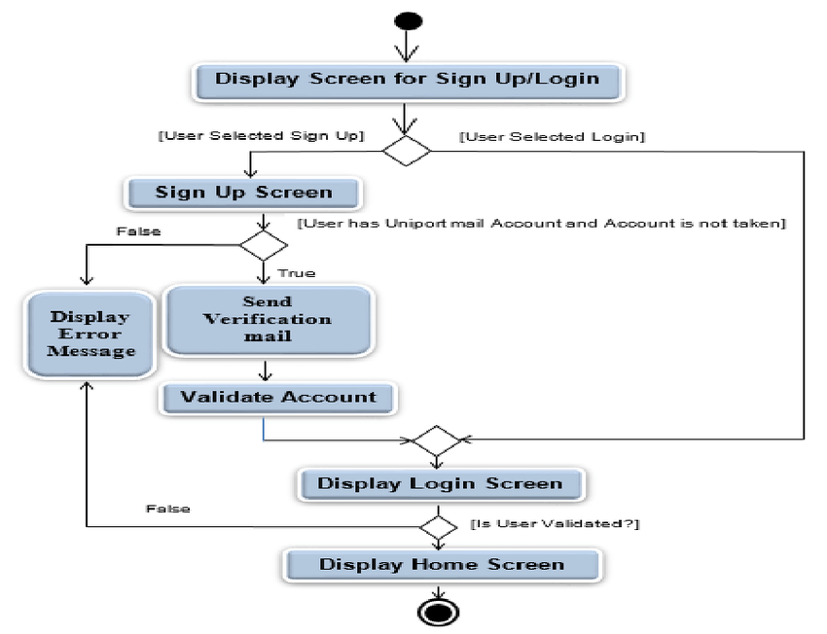
Sign up System - Activity Diagram
Figure 5: Working of Signup system Activity Diagram

Slide 13
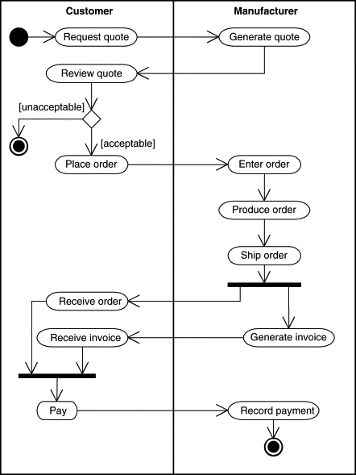
Order Placing - Activity Diagram
Figure 5: Working of Order Placing Activity Diagram

Slide 14
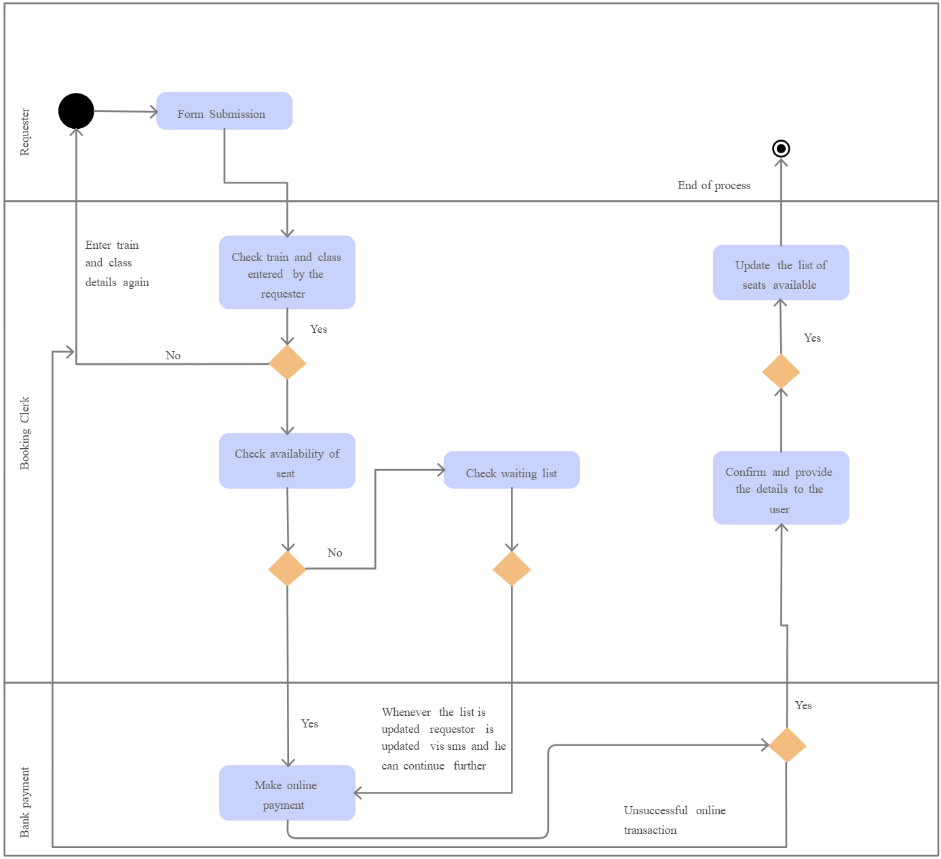
Railway Reservation System- Activity Diagram
Figure 6: Working of Railway Reservation System Diagram

Slide 15
Practice Questions
An example of UML activity diagram describing behavior of the Purchase Ticket use case for a Ticket vending machine.
Electronic prescriptions UML activity diagram example is based on documentation for the Electronic Prescription Service (EPS) R2 developed by the NHS Connecting for Health (NHS CFH) in England.
An example of UML activity diagram to resolve an issue in software design.
An example of activity diagram for online placing Order.
An example of activity diagram for EMail Connections.

Slide 16
Bibliography
https://www.visual-paradigm.com/guide/uml-unified-modeling-language/what-is-activity-diagram/
https://www.geeksforgeeks.org/unified-modeling-language-uml-activity-diagrams/
https://www.lucidchart.com/pages/uml-activity-diagram
https://www.smartdraw.com/activity-diagram/
https://creately.com/diagram/example/jlg33xw41/activity-diagram-for-login

